Slide 1
Different ways of representing documents and some similarity measures for document clustering

Slide 2

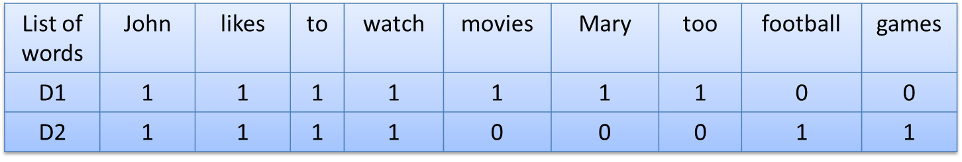
Sec. 6.2
Representation 1: Binary term-document incidence matrix
- Each document is represented by a binary vector ∈ {0,1}^{|V|} , Where |v| is size if vocabulary which will be the unique words in the document
Let two documents containing text:
D1: John likes to watch movies. Mary likes movies too.
D2: John likes to watch football games.

Slide 3
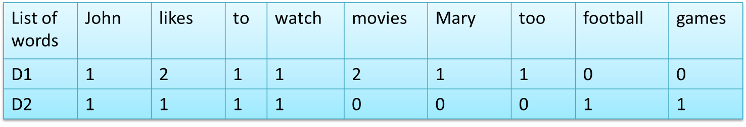
Representation 2: Term-document count matrices
Represent each word of document in terms of number of occurrence (denoted as - tf_{t,d} , the number of times term t occurs in document ‘d’):
  Each document is a count vector in |V| dimensional space
Let two documents containing text:
D1: John likes to watch movies. Mary likes movies too.
D2: John likes to watch football games.

Slide 4
Representation 2 : Disadvantage
Above representation known as Bag of words model (1-gram)
Disadvantage:
  Vector representation doesn’t consider the ordering of words in a document as documents .
    Example : ‘John is quicker than Mary’ and ‘Mary is quicker than John’ have the same vectors
      Solution : Use n-gram model where n>1

Slide 5
Representation 2 : Disadvantage
  A document with 10 occurrences of the term is more relevant than a document with 1 occurrence of the term. But, relevance does not increase proportionally with term frequency.
  Rare terms are more informative than frequent terms (stop words like is, am, are…..)
  Example:
    Consider a term in the query that is rare in the collection (e.g., arachnocentric)
    A document containing this term is very likely to be relevant to the query arachnocentric
→We want a higher weight for rare terms like arachnocentric. .But lower weights than for rare terms
.

Slide 6
Solution: tf-idf scheme
Statistical measure used to evaluate how important a word is to a document in a collection or corpus
  TF: Term Frequency, which measures how frequently a term(word) occurs in a document.
  TF(t) = (Number of times term t appears in a document) / (Total number of terms in the document)
  IDF: Inverse Document Frequency, which measures how important a term is.
  IDF(t) = log_{e}(Total number of documents / Number of documents with term t in it).

Slide 7
Example
Consider a document containing 100 words
wherein the word cat appears 3 times.
The term frequency (i.e., tf) for cat is then (3 / 100) = 0.03.
Now, assume we have 10 million documents and the word cat appears in one thousand of these.
Then, the inverse document frequency (i.e., idf) is calculated as log(10,000,000 / 1,000) = 4.
Thus, the Tf-idf weight is the product of these quantities: 0.03 * 4 = 0.12.

Slide 8
Representation 3 : Word2vec
Set of models that are used to produce word embeddings where words or phrases from the vocabulary are mapped to vectors of real numbers.
input a large corpus of text and produces a vector space, typically of several hundred dimensions, with each unique word in the corpus being assigned a corresponding vector
Captures the syntax and semantic relations between two documents.

Slide 9
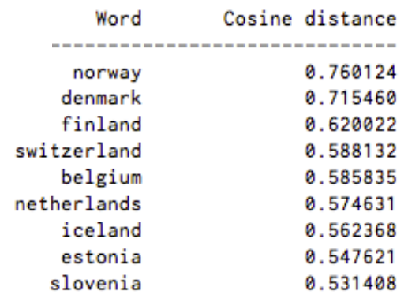
Word2vec Continued……
The purpose and usefulness of Word2vec is to group the vectors of similar words together in vector space.
Given enough data, usage and contexts, Word2vec can make highly accurate guesses about a word’s meaning based on past appearances
Here’s a list of words associated with “Sweden” using Word2vec, in order of proximity:
.

Slide 10
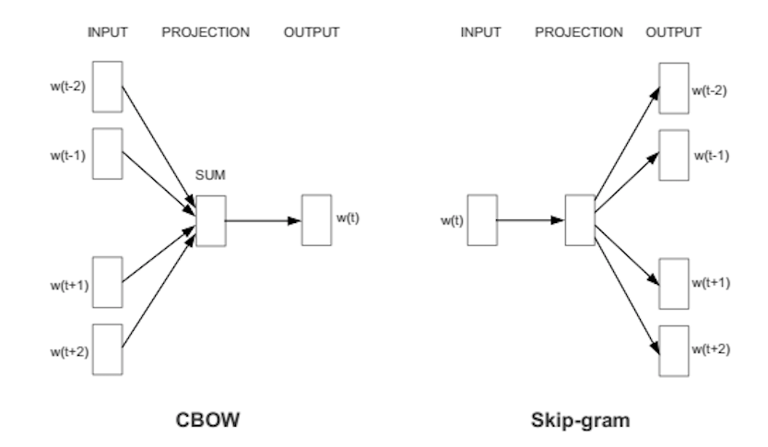
Word2vec Continued……
It does so in one of two ways, either using context to predict a target word (a method known as continuous bag of words, or CBOW), or using a word to predict a target context, which is called skip-gram

Slide 11
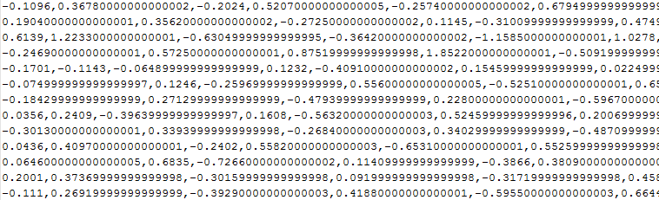
Word2vec : A snapshot
Word vector

Slide 12
How to generate document vector using word2vec?
After generating word vector of all words in the documents, these word vectors are get averaged to obtain the document vector.
Example:
Let a document have three words w1, w2 w3
their corresponding word vector : v1,v2,v3
document vector= (v1+v2+v3)/3

Slide 13
Computing similarity/dissimilarity between two document vectors
Cosine Similarity
Symmetric conditional probability based similarity
Correlation
Euclidean Distance
Squared Euclidean distance
Jaccard coefficient

Slide 14
Cosine similarity
d = (x₁ , x₂ , x₃ , ..., x_{n} ) →vector in an n-dimensional vector space.
Length of x is given by (extension of Pythagoras's theorem) :
|d|² = x₁² + x₂² + x₃² + ... + x_{n}²
|d| = (x₁² + x₂² + x₃² + ... + x_{n}² ) ½
If d₁ and d₂ are document vectors: Inner product (or dot product) is given by :
d₁ .d₂ = x₁₁x₂₁ + x₁₂x₂₂ + x₁₃x₂₃ + ... + x_{1n}x_{2n}

Slide 15
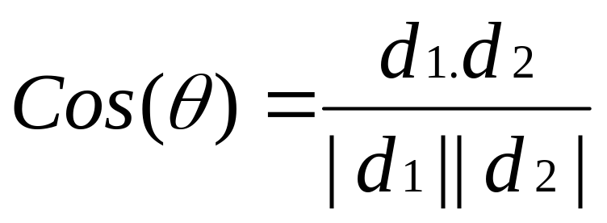
Cosine angle between the docs d₁ and d₂ determines doc similarity:
cos (Ө) = 1; documents exactly the same; = 0, totally different

Slide 16
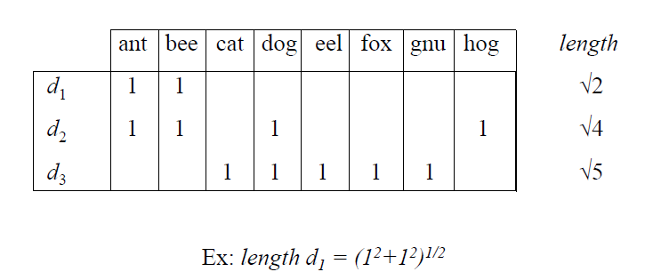
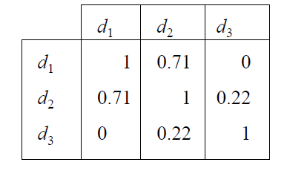
Example

Slide 17

SCP based similarity
It is calculated as
where ,
P(.,.) is the joint probability of two tokens (w₁ and w₂) appearing in the same word feature vector
P(.) is the marginal probability of any token appearing in a word feature vector.

Slide 18
Example input
they will call to office in Chennai
he needs to call to his mother in Hyderabad
why dont you call to your office and take leave today

Slide 19
Corresponding Word vocabulary
They
Will
Call
To
Office
In
Chennai
He
Need
His
Mother
Hyderabad
Why
Do-nt
You
Your
And
Take
Leave
today

Slide 20
They
Will
Call
To
Office
In
Chennai
He
Need
His
Mother
Hydrabad
Why
Dont
You
Your
And
Take
Leave
today
1
 | 1
 |  | 1 |  | 0.7
 |  |  | 1
 |  | 0.7
……………………………………………………………………………..
They
Will
Call
To
Office
In
Chennai
He
Need
His
Mother
Hydrabad
Why
Dont
You
Your
And
Take
Leave
today

Slide 21
Example: To calculate SCP(call,office)
P(call,office)²→(2/3)²
P(call)→(3/3)\
P(office)→(2/3)
SCP(call,office)={(4/9)*(3/3)*(3/2)}=0.7

Slide 22

In order to calculate similarity between two documents this SCP measure can be used in the following way,
Where, S(d_{i},d_{j})→ similarity between two documents d_{i} and d_{j}.
GIAN-MOO

Slide 23
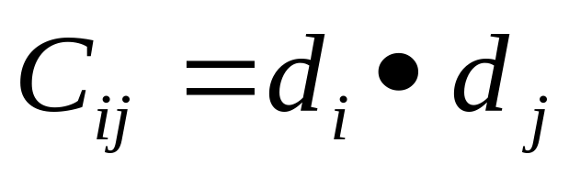
Correlation
The dot product of the term vectors of two documents gives an indication to the correlation between the documents.
This is based on the intuition that documents that describe similar topic are more likely to share words.
The correlation between two documents d_{i} and d_{j} due to
textual content is given by

Slide 24
Example of correlation
C_{d1d2} =d₁ d₂ = (1*1)+(1*1)+(0*0)+(0*1)+
(0*0)+(0*0)+(0*0)+(0*1)=2

Slide 25
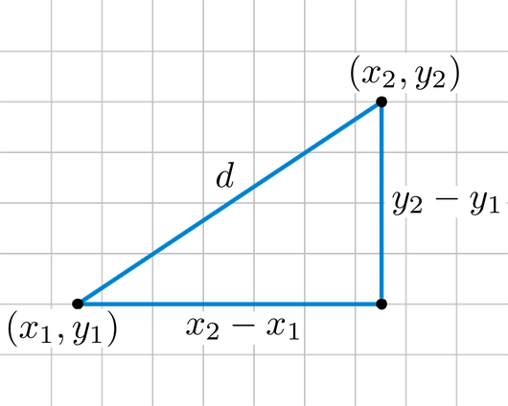
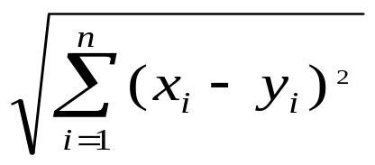
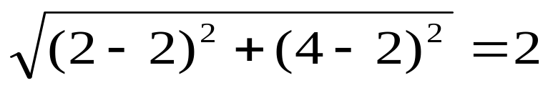
Euclidean distance
Adds up all the squared distances between data points x and y, and takes the square root of the result.
Example : (x1,y1)=(2,4) , (x2,y2)=(2,2)

Slide 26

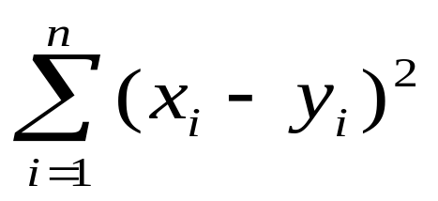
The Euclidean Squared distance metric uses the same equation as the Euclidean distance metric.
It does not take the square root. As a result, clustering with the Euclidean Squared distance metric is faster than clustering with the regular Euclidean distance.

Slide 27
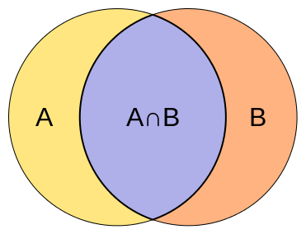
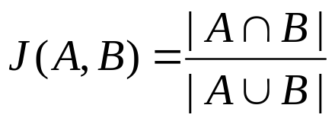
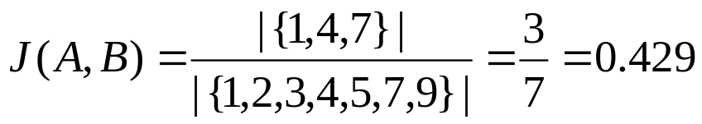
Jaccard Cofficient
measures similarity between finite sample sets
also known as Intersection over Union
J(A,A) = 1
J(A,B) = 0 if A ∩ B = 0
A and B don’t have to be the same size.
Always assigns a number between 0 and 1.
Example : A={7,3,2,4,1}, B={ 4,1,9,7,5}

Slide 28
Acknowledgement
https://skymind.ai/wiki/word2vec
GIAN-MOO

Slide 29
Thank you!!
GIAN-MOO

